Slide 1
HCI Group Project (Kiambu County Website - https://kiambu.go.ke/)
Project Members
Anthony Wangala- SCT221-0170/2019
Anthony Lesiri -SCT221-0400/2019
Langat Nelson- SCT221-0324/2019
Brian Orina -SCT221-0314/2019
Felix Kamau – SCT221-0382/2017

Slide 2
INTRODUCTION
Nestled in the central region Kenya, Kiambu County boasts a rich cultural heritage, stunning landscapes, and a vibrant community. The website, which serves as the official online platform for Kiambu County, located in Kenya, aims to provide residents, visitors, and stakeholders with essential information and services related to the county's governance, resources, and events.
With a focus on transparency, efficiency, and public engagement, the website strives to facilitate seamless access to government services, promote local development initiatives, and foster a sense of belonging and pride among the county's diverse population.

Slide 3
Problem Statement
The Kiambu County website faces several crucial Human-Computer Interaction (HCI) issues that hinder user experience. Mobile navigation is challenging due to the absence of an accessible menu button, while the search and filter function prove ineffective on PCs and entirely missing on mobile devices. The site lacks a distinctive name or logo, leading to confusion and skepticism among users. Missing images reduce visual appeal, while slider images are poorly visible on mobile screens. Misplaced links disrupt information access. Addressing these issues through intuitive navigation, optimized search, branding, visual elements, and link organization will create a user-friendly and engaging website.

Slide 4
Ineffective Search and Filter Function on PC, Non-existent on Mobile
The Kiambu County website faces an HCI issue concerning its search and filter functionality. On PC web browsers, the search and filter feature proves ineffective, making it challenging for users to refine their searches and find specific information. Moreover, this critical feature is entirely absent on the mobile phone web browser, depriving mobile users of a crucial tool to access relevant content quickly.
To address this, the website should focus on optimizing the search and filter functionality for PC users, enabling them to refine their searches effectively. Simultaneously, introducing a mobile-friendly search and filter feature would cater to users accessing the site from their smartphones, providing a consistent and user-friendly experience across all devices.

Slide 5
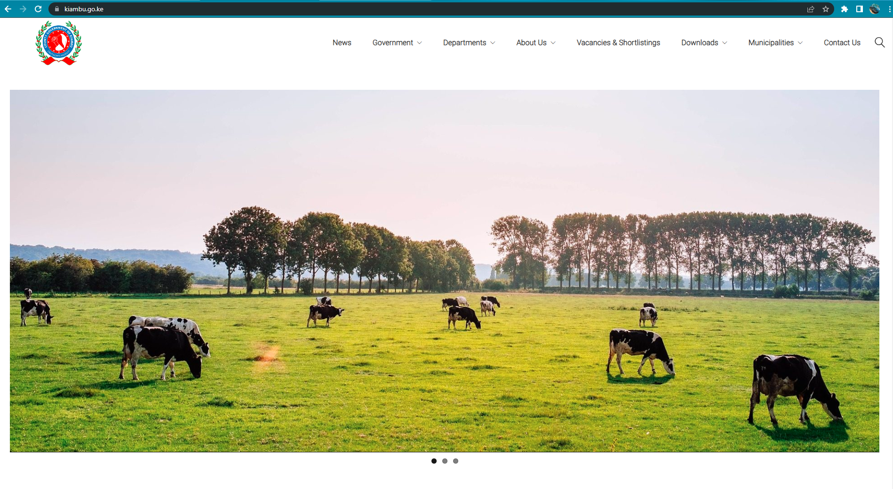
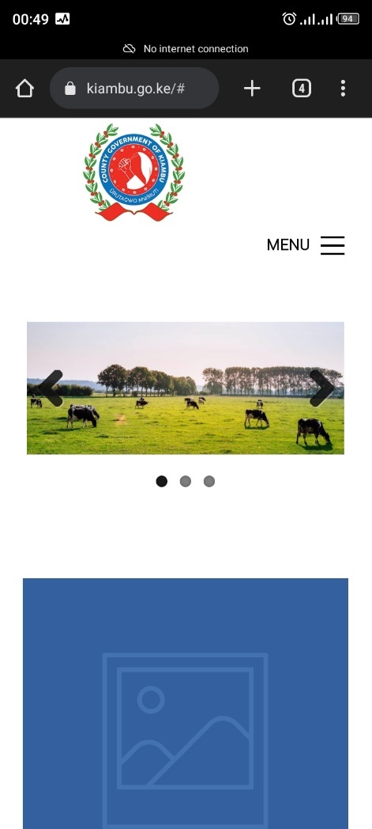

Slide 6
2. Missing Images Diminish User Experience
The HCI issue of missing images throughout the website detracts from the overall user experience. Visual content plays a crucial role in conveying information and engaging users.
When relevant images are absent, users may find it difficult to comprehend the content fully, leading to reduced interest and lower retention of information.
By thoughtfully incorporating relevant images, graphics, and icons, the website can convey information more effectively and engage users on a deeper level. Addressing this deficiency in visual content will result in a more visually appealing and engaging website for visitors.

Slide 7
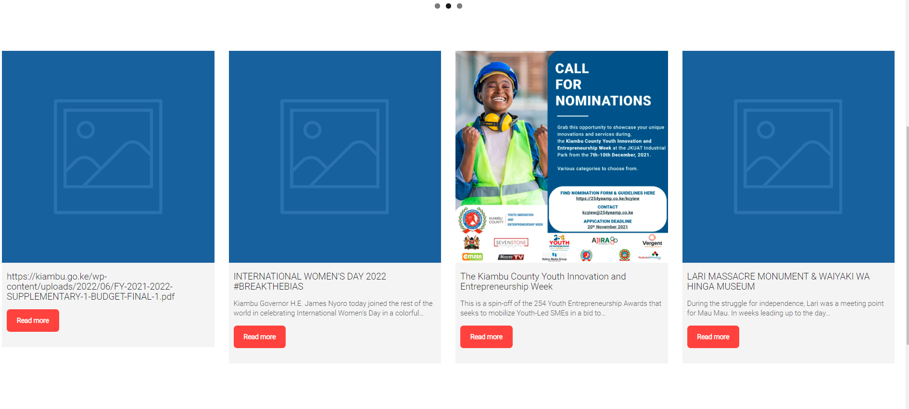

Slide 8
3. Poor Mobile Navigation
The website of Kiambu County presents a significant HCI issue on mobile phone web browsers, as it lacks a functional menu button. Users encounter difficulties in navigating the site and finding relevant information, resulting in a frustrating user experience.
To address this concern, implementing an improved mobile navigation system with a clearly visible and easily accessible menu button is essential. By doing so, users will be able to seamlessly explore different sections of the website, enhancing their overall browsing experience.

Slide 9
4. Lack of Website Identity and Branding
A pressing HCI issue on the Kiambu County website is the absence of a distinctive name or logo, which significantly impacts the site's branding and identity. Users visiting the website may find it challenging to identify and associate it with Kiambu County, potentially leading to confusion or skepticism about its legitimacy.
To rectify this issue, the site should prominently display the name of Kiambu County, making it instantly recognizable and reinforcing the brand identity of the local government.
This is essential for building trust and fostering a sense of familiarity with users, reinforcing the website's affiliation with the local government and enhancing overall user engagement.

Slide 10
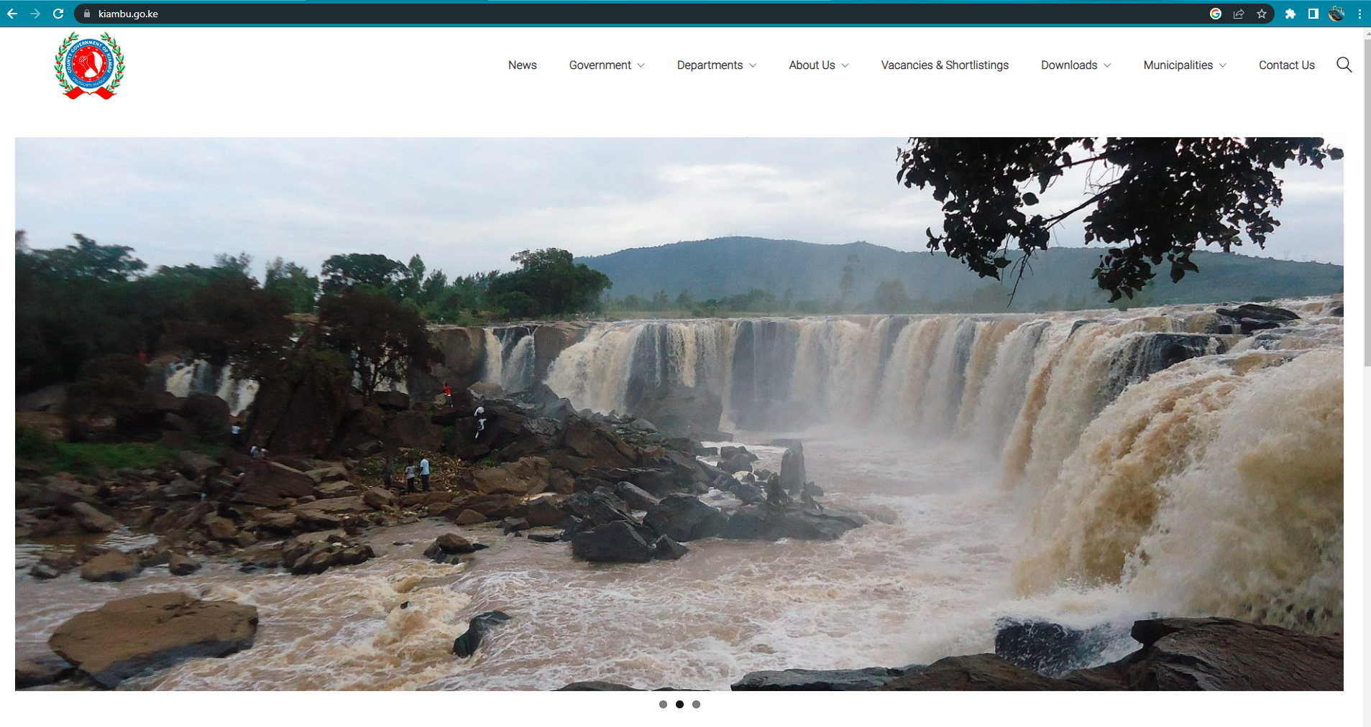

Slide 11
5. Misplaced Links in Descriptions Affect User Usability
The misplacement of links within descriptions presents an HCI issue on the website. Users trying to access related content may encounter confusion and frustration due to the unclear placement of links. This negatively impacts user usability and disrupts the flow of information retrieval.
To address this problem, a thorough review of all content descriptions should be conducted to ensure that links are appropriately placed and easy to find. This improvement will not only enhance the website's usability but also facilitate better information access for users, contributing to a more seamless browsing experience.

Slide 12
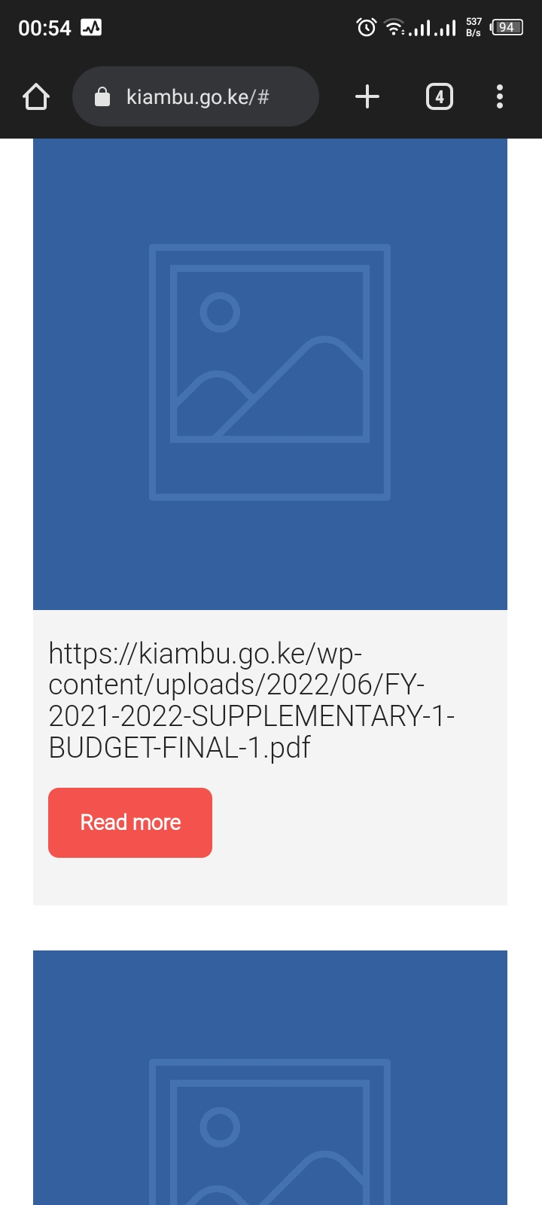
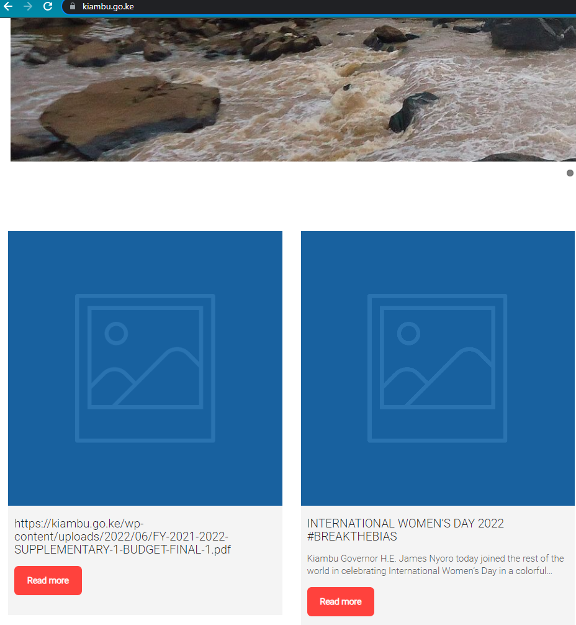

Slide 13
6. Impaired Visibility of Slider Images on Mobile
The website's slider images pose an HCI issue on mobile phone web browsers due to poor visibility. Mobile devices' limited screen size makes it challenging for users to perceive slider images clearly. This leads to a subpar user experience, as users may miss essential information or fail to understand the context presented in the slider.
To overcome this, the website should implement a responsive design that optimizes slider images for mobile browsing. This involves adjusting image sizes, considering legibility, and ensuring seamless navigation between different slider elements, providing a more user-friendly experience for mobile users.

Slide 14
Context Analysis
Cultural and Social Context:
In designing the Kiambu County website, consideration of the users' cultural norms and behaviors is crucial. The website aims to cater to the diverse needs of residents, businesses, and visitors of Kiambu County, providing easy access to essential information, government services, tourism attractions, and business resources. It must be user-friendly, inclusive, and prioritize accessibility for people with disabilities.
Physical Context:
Given the high mobile penetration in Kiambu County, the website should have a responsive user interface, accommodating users who primarily access the internet through mobile devices like Nelson. Privacy, support for multiple languages, and reliable internet connectivity are important considerations. Localized content and geo-location-based services should be integrated to cater to the county's geographical diversity, serving both urban and rural populations. The website's design should be legible, with intuitive navigation and offline capabilities to ensure access during internet disruptions.

Slide 15
Context Analysis(continuation)
Organizational Context:
Managed by the county Government of Kiambu, the organizational context of the Kiambu County website involves examining the internal structure, processes, and decision-making within the organization. The primary goal is to provide a user-friendly platform that meets the needs of residents, businesses, and visitors. Collaboration with stakeholders, resource management, user engagement, and continuous improvement through training and development are essential aspects of maintaining the website's effectiveness and relevance.

Slide 16
User Analysis
The objective is to create a user-friendly and efficient system by utilizing personas as a tool in user analysis. These fictional characters are based on real user data and behaviors, enabling designers and developers to empathize with users and maintain a user-centric approach throughout the design and development process. The users of the Kiambu County website can be broadly classified into three main categories:
Residents of Kiambu County: Local residents who seek information on government services, healthcare, education, social welfare, agriculture initiatives, and resources impacting their daily lives and well-being.
Businesses in Kiambu County: Business owners, entrepreneurs, and managers looking for government regulations, business licenses, market insights, networking events, and support services to enhance their operations and growth.
Visitors to Kiambu County: Tourists and visitors exploring the county, seeking information about its history, culture, attractions, events, accommodations, and travel-related services to plan their visit and enrich their experience.
By catering to the specific needs of these user groups, the Kiambu County website becomes a valuable and inclusive platform benefiting residents, supporting local businesses, and promoting tourism and cultural appreciation in the region.

Slide 17
Persona Buyer Persona- Nelson, Entrepreneur
Demographics:38 years old Male, Entrepreneur and Businessman who lives Nairobi, Kenya
Goals: Nelson wants to access up-to-date information about business regulations, licensing requirements, and permits in Kiambu County. He aims to start a new business venture in the region and needs clear guidelines to facilitate the process.
Behaviors: Nelson relies heavily on his smartphone for accessing information and conducting business tasks. He frequently uses mobile apps to manage his business and browse the internet on the go. Being an experienced businessman, Nelson is proactive in researching business-related topics. He seeks reliable and accurate information to make informed decisions. Nelson values his time and prefers websites that are easy to navigate, providing quick access to the information he needs without unnecessary delays.
Needs/Challenges: Nelson needs the Kiambu County website to have an intuitive user interface that allows him to find relevant business information easily. Nelson faces the challenge of finding information specifically tailored to businesses in Kiambu County. He needs the website to provide localized content and resources relevant to his business endeavors in the region.

Slide 18
Persona(continuation) Seller Persona- Brian - Manager Advertising Job Opportunities via Kiambu County Website
Demographics: 42 years old Male, Manager at a mid-sized company in Kiambu County, Kenya
Goals: Brian's primary goal is to advertise job opportunities available at his company through the Kiambu County website. He wants to attract qualified candidates from the local talent pool and find the right fit for the vacant positions. Brian wants the job advertisements to reach a wide and diverse audience within Kiambu County. He seeks a platform that ensures the job postings are visible to both skilled professionals and recent graduates seeking employment opportunities.
Behaviors: Brian actively uses the internet and digital platforms to manage business-related tasks. He is familiar with online job portals and social media platforms to recruit potential candidates. Brian values time efficiency and seeks a user-friendly website that allows him to post job advertisements quickly and efficiently, ensuring minimal disruptions to his busy schedule.
Needs/Challenges: Brian needs the Kiambu County website to have a simple and straightforward job posting process. It should include clear instructions and relevant fields to input essential job details. To attract a wide pool of applicants, Brian requires the website to have a prominent and well-organized job board where his advertisements will be highly visible to potential candidates.

Slide 19
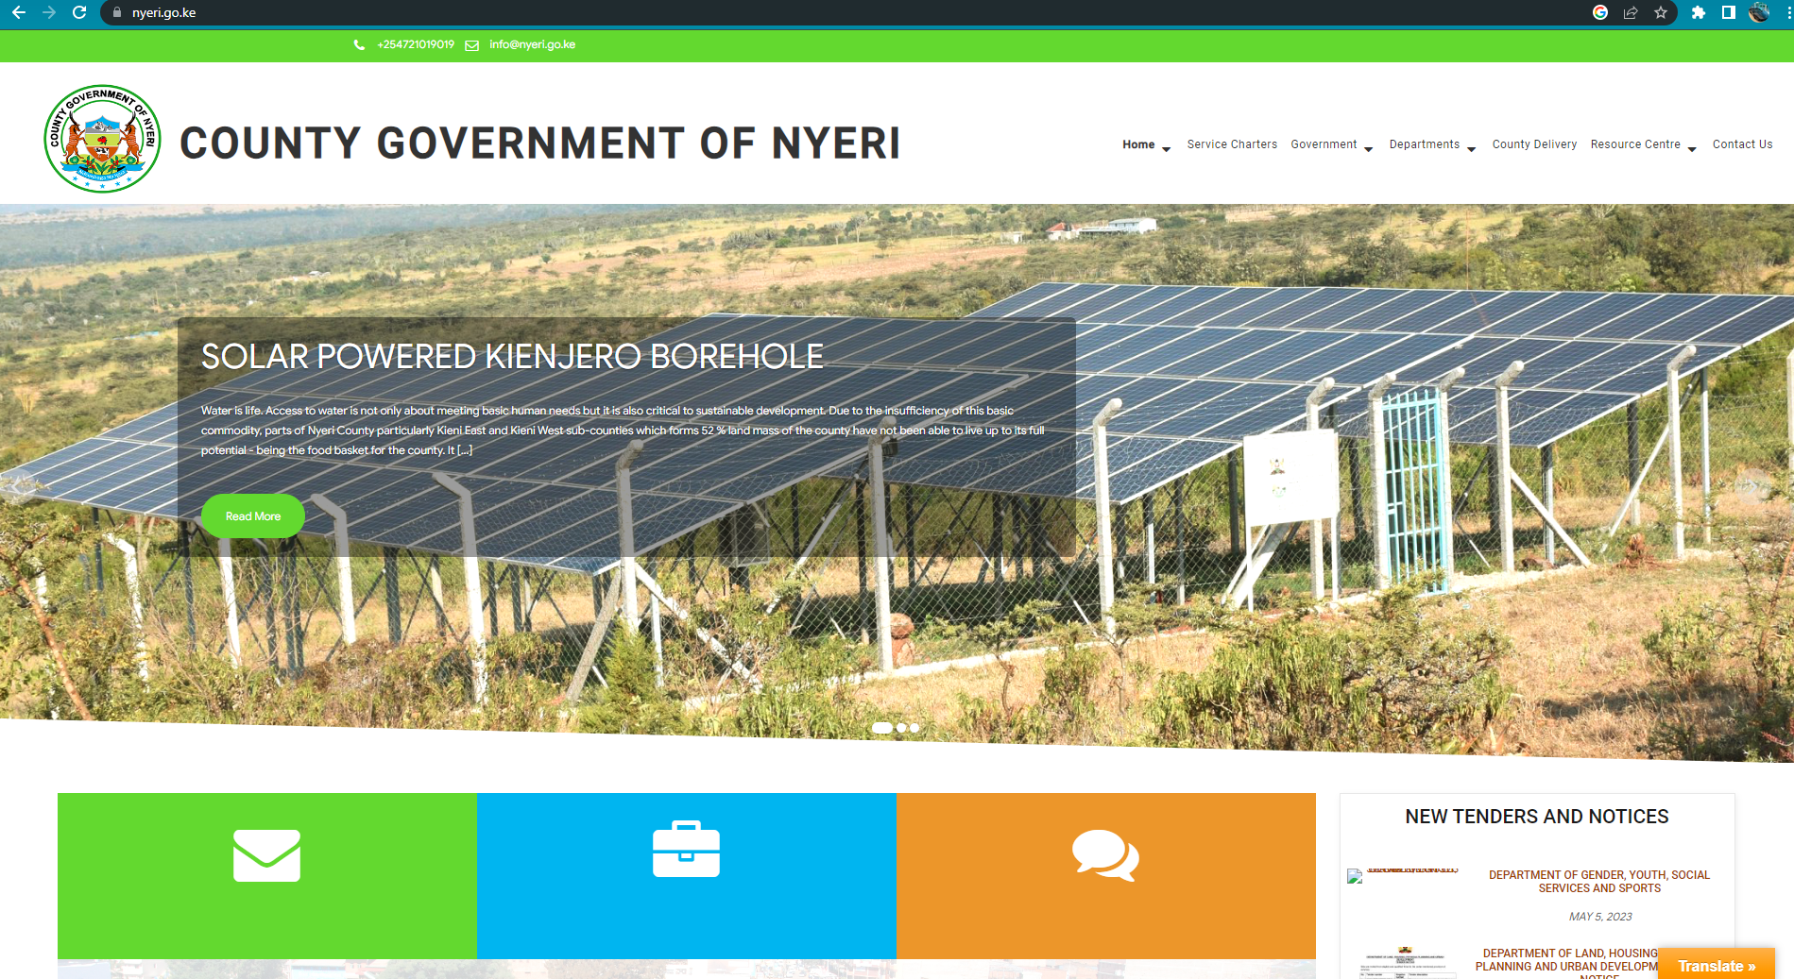
Domain Analysis
The Nyeri County website, www.nyeri.go.ke, is a comprehensive online platform designed to cater to the needs of residents, businesses, and visitors of Nyeri County, Kenya. It serves as a resource hub, providing accurate and up-to-date information about government services, healthcare facilities, education opportunities, business resources, and local attractions. The website prioritizes accessibility, offering a user-friendly interface for all users, including those with disabilities, and featuring localized content and multiple language options. Integration with local organizations promotes community engagement and collaboration.

Slide 20
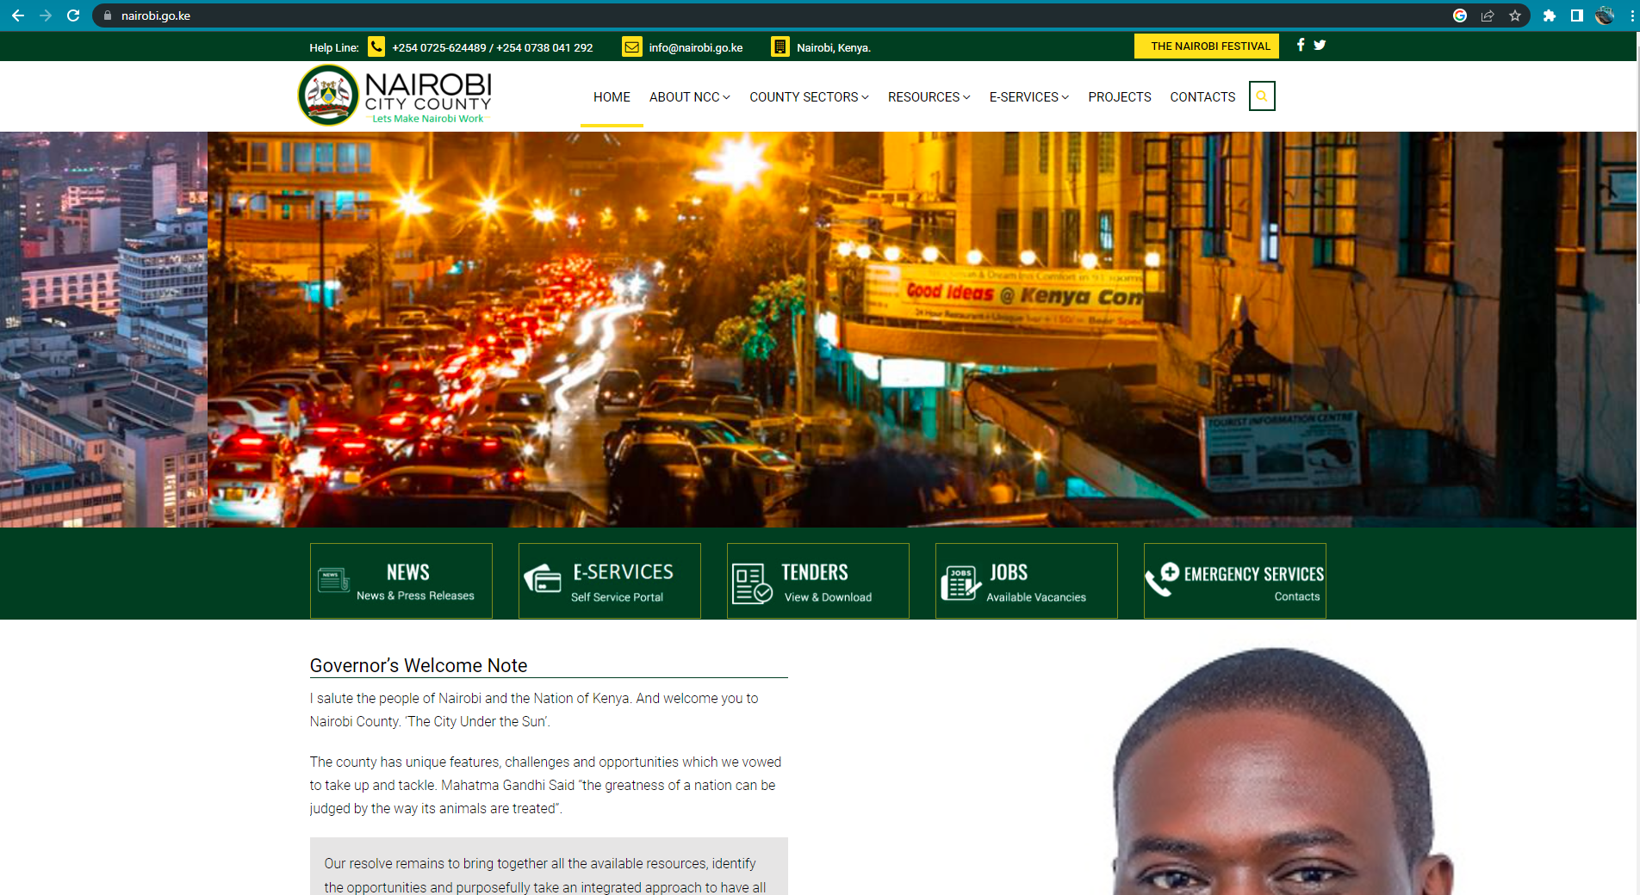
Domain Analysis (Continuation)
The Nairobi County website is a comprehensive online platform dedicated to meeting the needs of residents, businesses, and visitors in Kenya's capital city. It offers a wide range of information and services, including government resources, healthcare facilities, education institutions, business regulations, tourism attractions, and cultural events. The website's user-friendly interface ensures easy access for all users, regardless of their device or accessibility requirements. It features localized content and supports multiple languages, primarily English and Swahili, to cater to Nairobi's diverse community. Collaborating with local organizations and government bodies ensures accuracy and relevance.

Slide 21
THE END

